Slide 1
Solving SET Game
Using Computer Vision
Manvendra Kumar Nema
MT22038
Saurabh Yadav
PhD20023
Tarang Dineshbhai Viroja
MT22081

Slide 2

Introduction to Set Game
The deck consists of 81 unique cards that vary in 4 attributes across 3 possibilities for each kind of attribute:number of shapes,shape,shading and color

Slide 3
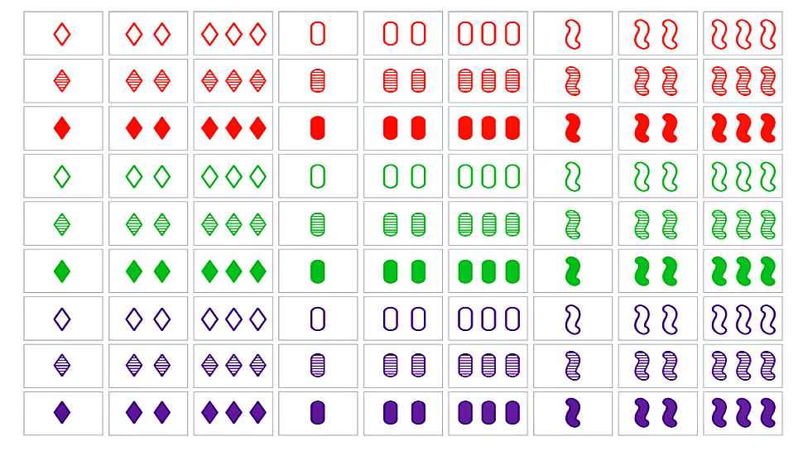
Attributes
Color:- Red,Green,Purple
Shape:-Oval,Diamond,Squiggle
Quantity:-One,Two,Three
Shading:-Blank,Striped,Solid

Slide 4
What is a Set ?
A set is a collection of three cards in which each of the four attributes are all the same or are all different

Slide 5
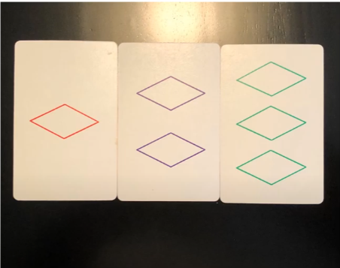
Example 1 of a set
Colors = different
Shapes = same
Quantities = different
Shadings = same

Slide 6
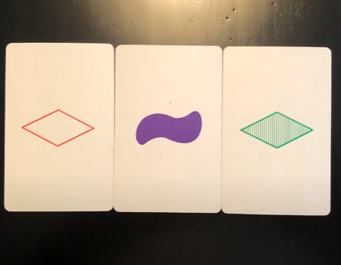
Example 2 of a set
Colors = different
Shapes = different
Quantities = same
Shadings = different

Slide 7
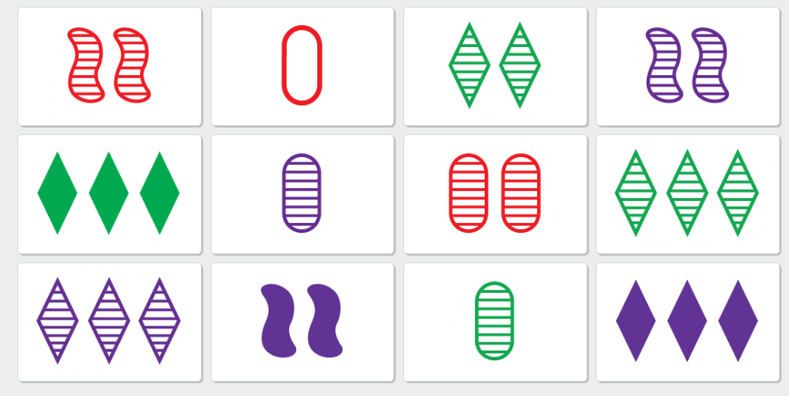
Techniques
Computer Vision Based Techniques
Deep Learning Based Techniques

Slide 8
Computer Vision Techniques

Slide 9
Problem
Separate individual cards from combined image.
Attribute
Color identification
Number identification.
Shape and Shade identification
Find correct set combination

Slide 10
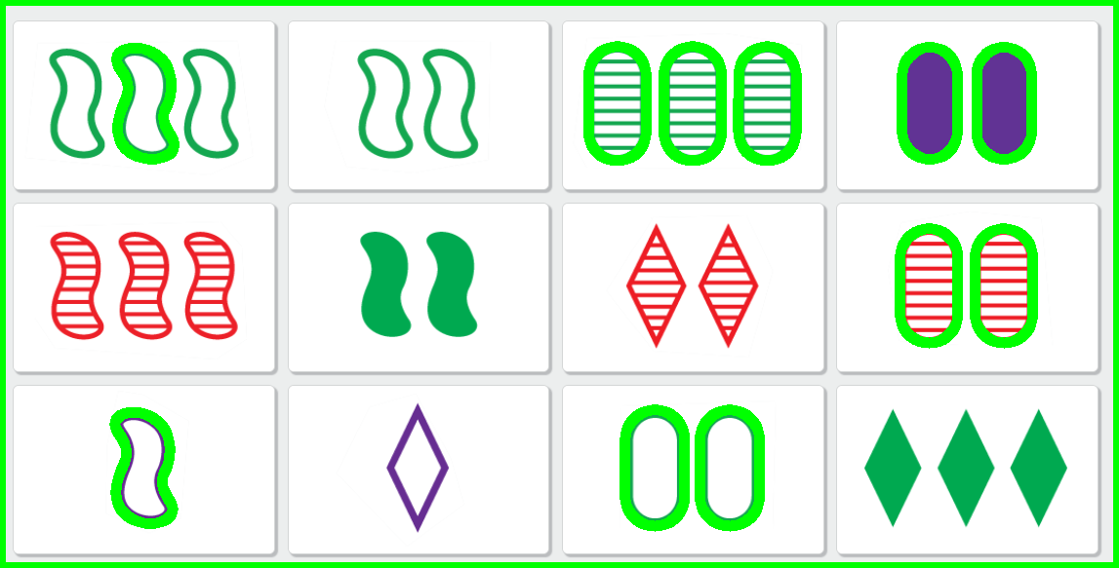
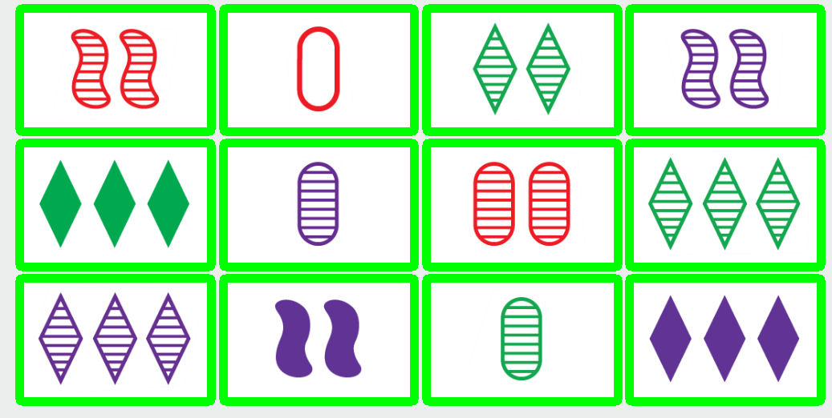
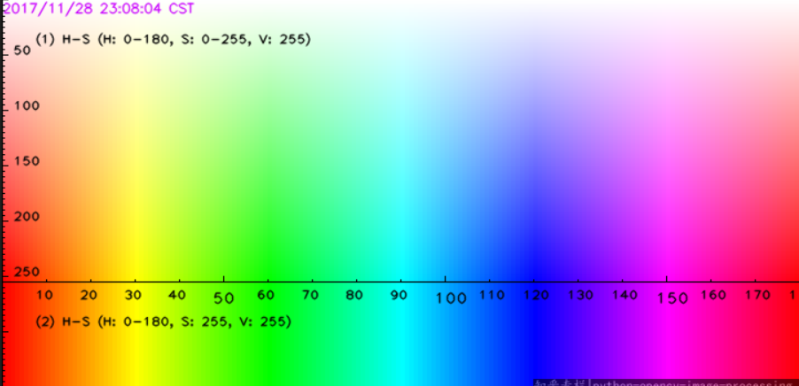
Separate Cards and Color Identification
‘findcontour’ method to separate each card from collection
Color thresholding
HSV thresholding

Slide 11




Number Identification
Pixel Counting
Box with Non Maximum Suppression
Non zero pixel boundary width.

Slide 12



Shade and Shape Identification
Pixel Counting
Parallel Lines
Contour Matching
Template Matching

Slide 13
Deep Learning Techniques

Slide 14



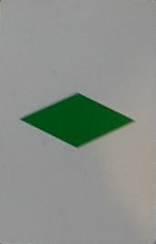


Attributes Identification
Collect Dataset for training
Kaggle-https://www.kaggle.com/datasets/kwisatzhaderach/set-cards
SET github-https://github.com/tomwhite/set-game
Total images: 1,943
Total images: 13,149

Slide 15
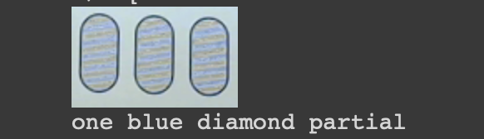
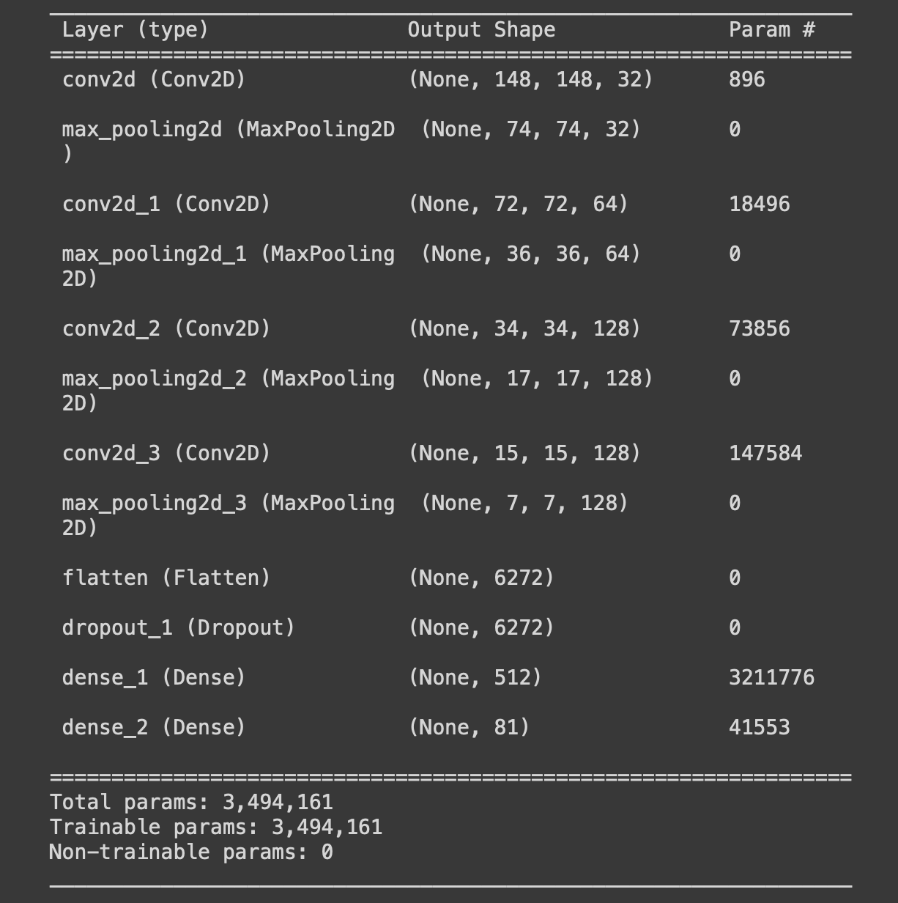
Attributes Identification
Two approaches for training:
Identify number, color, shape, fill separately
We finetune pretrained MobileNet
We create small CNN model from Scratch
Construct 81 classes for all possible 81 combinations
We create a CNN model with 4 convolution layers

Slide 16
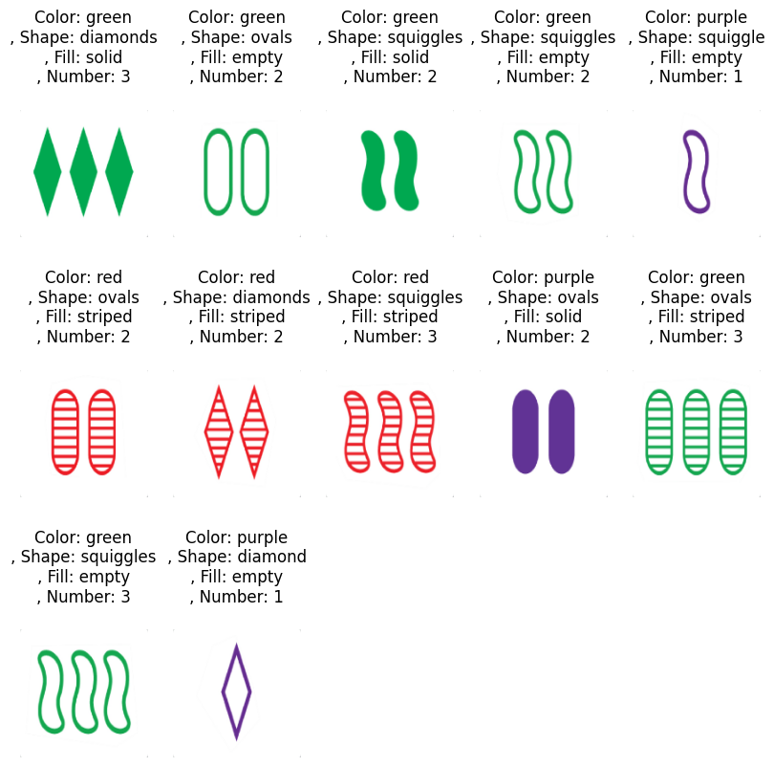
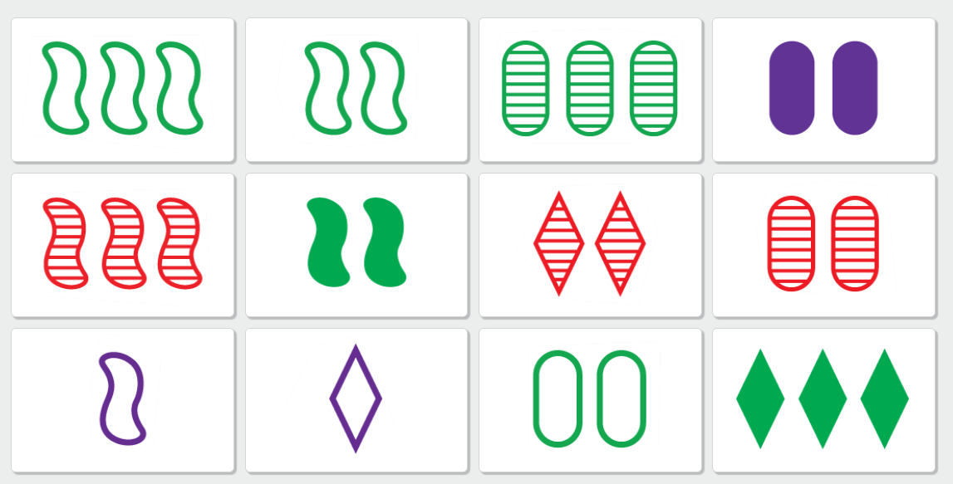
Attributes Identification

Slide 17
Individual Contribution
Manvendra Kumar Nema:
Card Separation, Color identification, Shape and shade Identification, Number Identification
Saurabh Yadav:
Number Identification, Dataset preparation, DL based approaches
Tarang Dineshbhai Viroja:
Dataset preparation, Problem identification, Rules definition, Shape and shade Identification
Overall every member contributed equally to the project

Slide 18
Thank You

